Slide 1
Maps

Slide 2
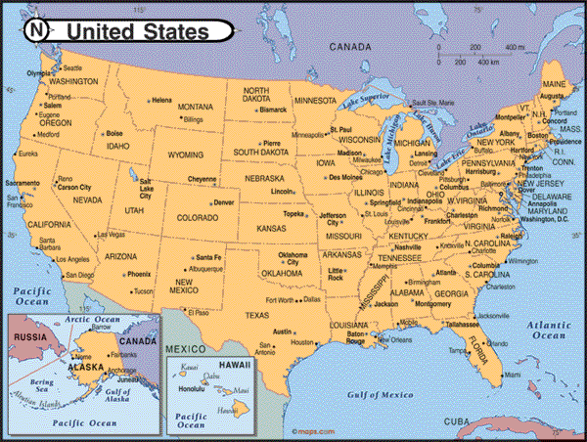
The World Political
Political maps show how people have divided places on the Earth into countries, states, cities and other units for the purpose of governing them.

Slide 3
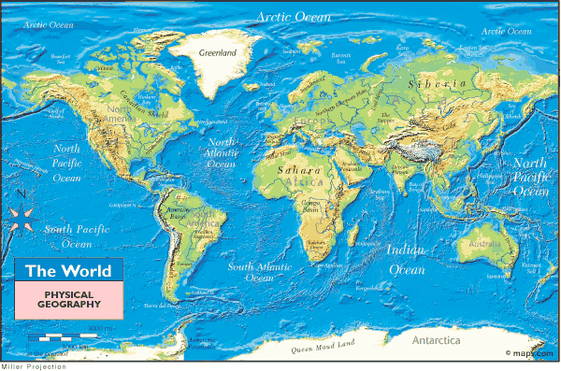
The World Physical
Physical maps show what the surface of the Earth looks like.

Slide 4
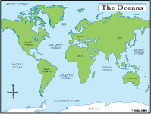
Oceans of the World
The world has four major oceans.
Atlantic
Pacific
Arctic
Indian
Arctic
ocean
Pacific
ocean
Indian
ocean
Atlantic
ocean

Slide 5
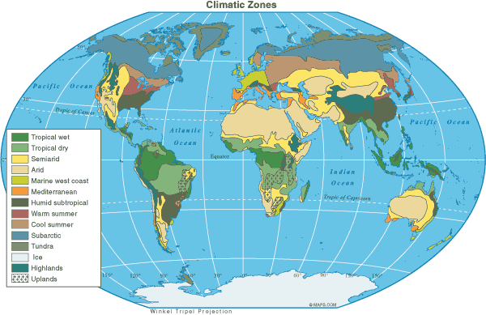
Global Climates
Students generally associate Arctic and Antarctic with cold weather, so students could make the observation that the climate at the poles is cold. This map shows the general climate regions of the world.

Slide 6
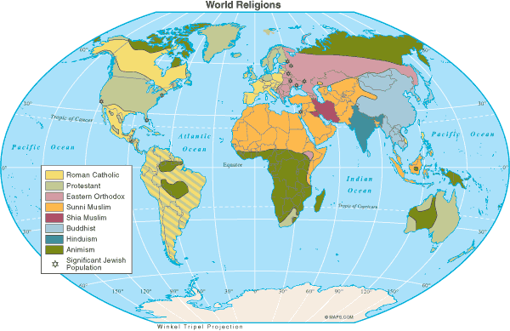
World Religions
Religious beliefs help define a people’s culture, so to understand a people, it is important to consider what religions influence that group.

Slide 7
Map Review
What is the purpose of a Political map?
To show borders of countries, states, cities

Slide 8
Map Review
What is the purpose of a Physical map?
Physical maps show what the surface of the world looks like

Slide 9
Map Review
What are the four major oceans of the world?
Atlantic
Pacific
Arctic
Indian

Slide 10
Map Review
Why is it important to understand a people’s religion?
because religion helps shape their culture

